Slide 1

Visualization Fundamentals

Slide 2
Objectives
Define the terms probability, random variable, random events, theoretical probability, and experimental probability, and cumulative distribution function.
Calculate probability of an event given a normally distributed data set.
Explain how to use a normal distribution and a T-distribution to accept or reject a null hypothesis.
Explain how the mean and the standard deviation relates to a normal distribution and a T-distribution.
Visualization Fundamentals

Slide 3
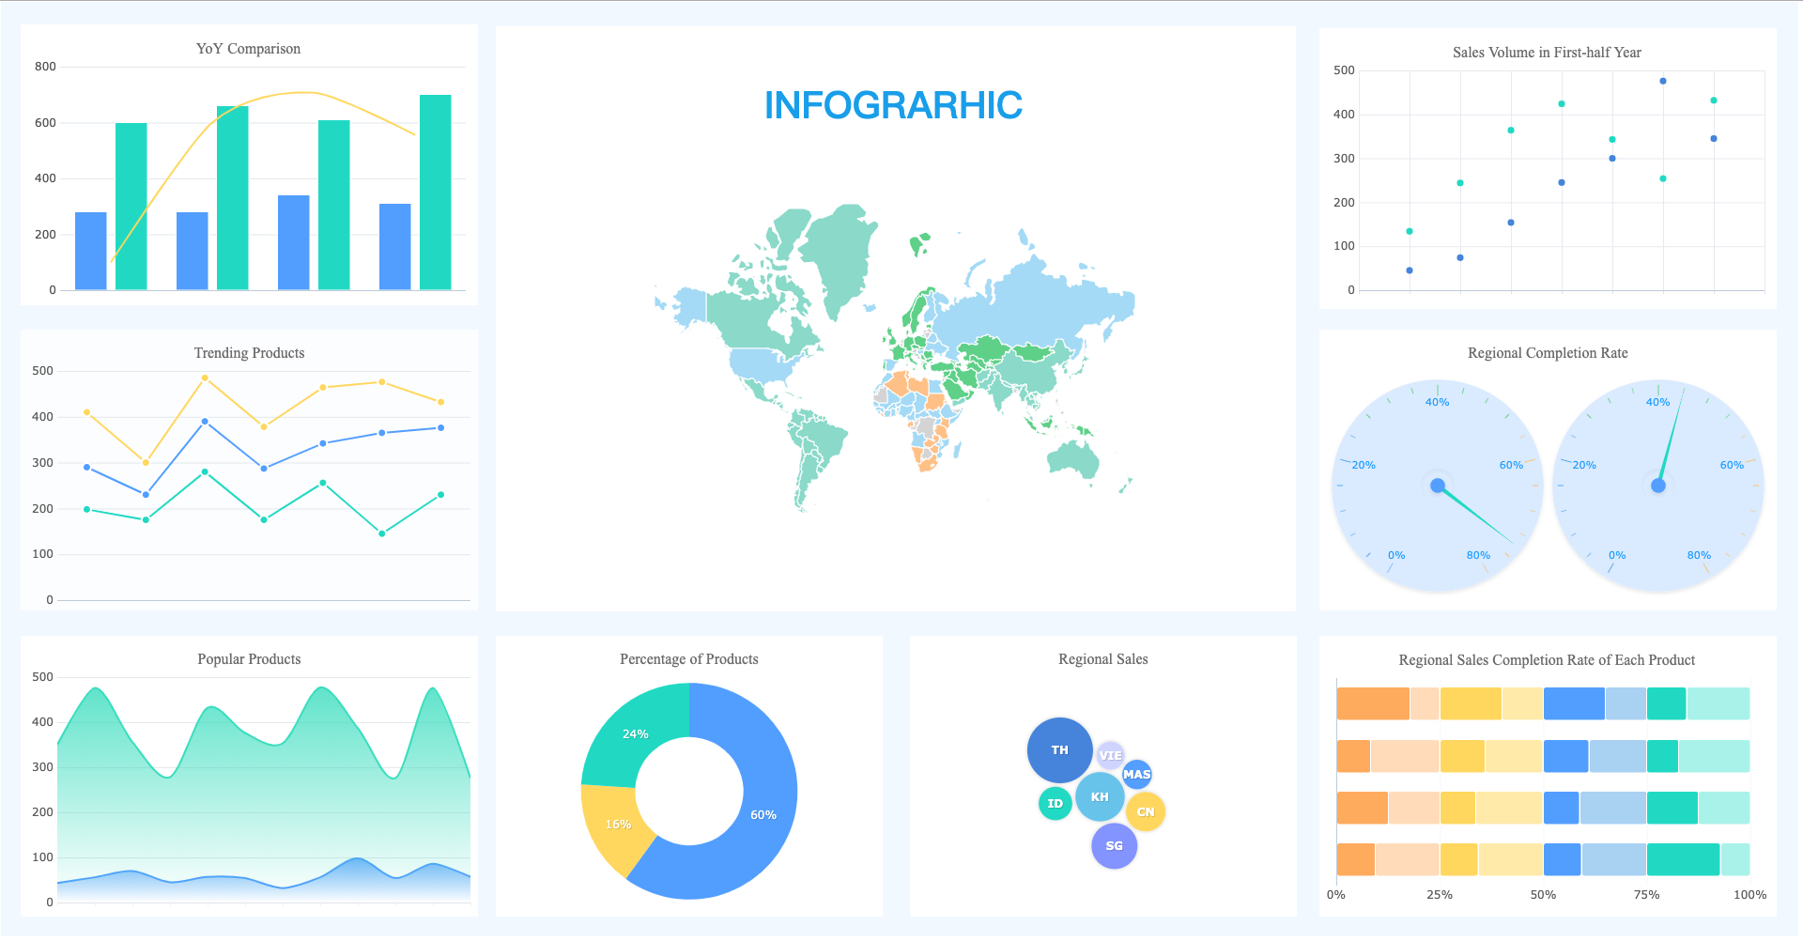
What is data visualization
Data visualization is presenting structured or unstructured data graphically to present information hidden in the data directly to people.
Visualization Fundamentals

Slide 4
Visualization fundamentals
The most important thing to realize is that the type of visualization you will use depends upon the type of variables you're trying to analyze.
Example:
  if you're working with categorical variables such as gender, you have to rely on a certain type of charting tools than if you were to be working with continuous variables such as age and income.
  In one case, you may be using bar charts, in another case, you will be required to use scatter plots.
Visualization Fundamentals

Slide 5
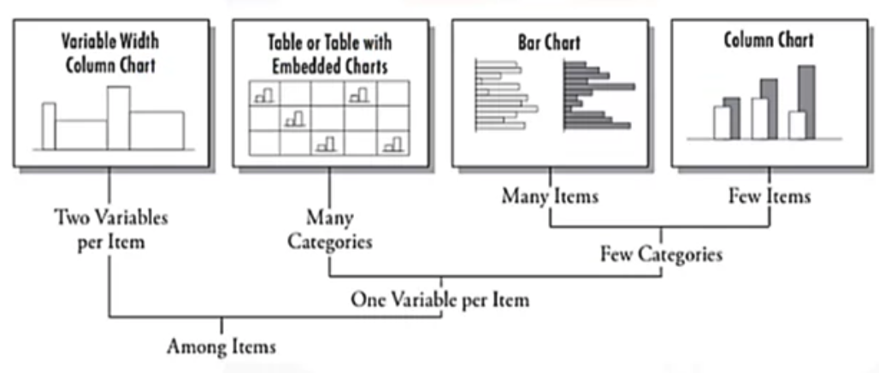
Visualization
If you're comparing items with few categories, you can use bar charts or column charts.
Visualization Fundamentals

Slide 6
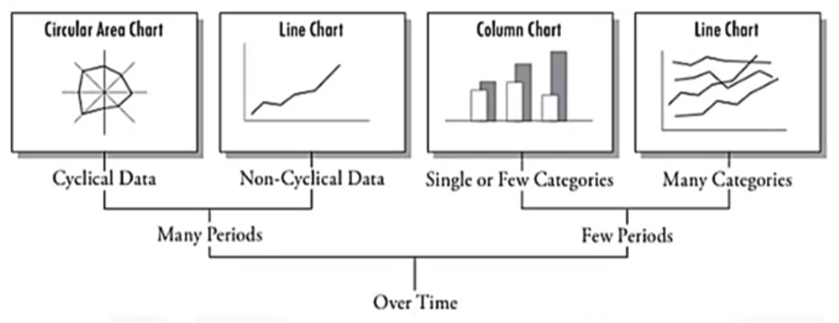
Visualization
If you are comparing behaviors over time and if you have the time periods running into several months, you may have to use a line chart.
Visualization Fundamentals

Slide 7
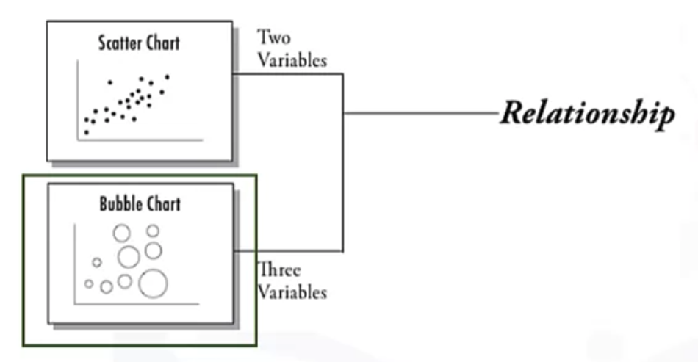
Visualization
If you're trying to depict relationships between two continuous variables, your choice is a scatterplot.
Visualization Fundamentals

Slide 8
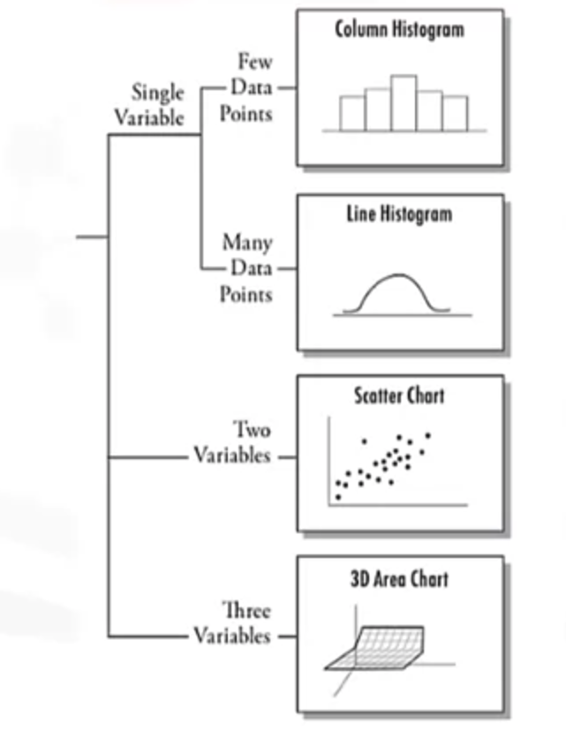
Visualization
If you're interested in depicting the distribution of the dataset, you can use the histogram, which could be a bar chart type of histogram or a line histogram
Visualization Fundamentals

Slide 9
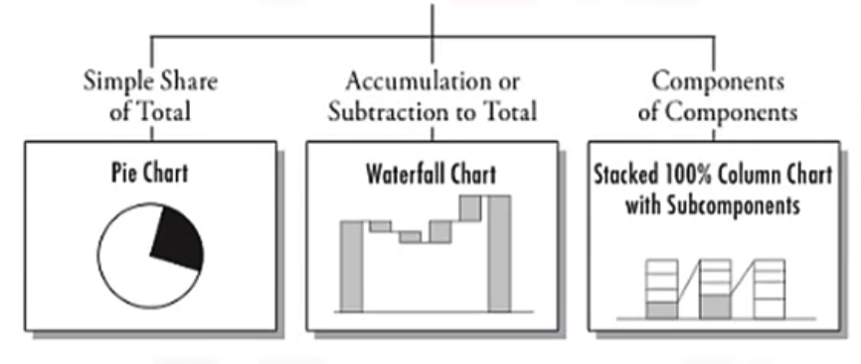
Visualization
If you would like to show the composition, then if it's a static data, you can use pie charts.
Visualization Fundamentals

Slide 10
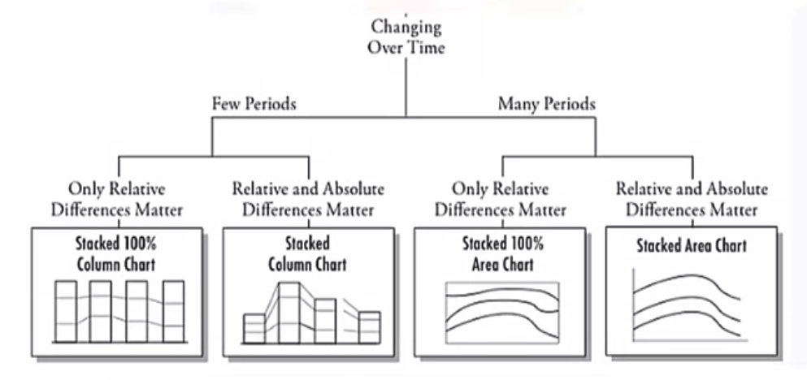
Visualization
If you're showing the composition that changes over time for few periods, you can use stacked columns
Visualization Fundamentals

Slide 11


Visualization- charts in python
Visualization Fundamentals

Slide 12
Summary
Define the terms probability, random variable, random events, theoretical probability, and experimental probability, and cumulative distribution function.
Calculate probability of an event given a normally distributed data set.
Explain how to use a normal distribution and a T-distribution to accept or reject a null hypothesis.
Explain how the mean and the standard deviation relates to a normal distribution and a T-distribution.
Visualization Fundamentals

Slide 13
Q & A
Visualization Fundamentals

